Slide 1
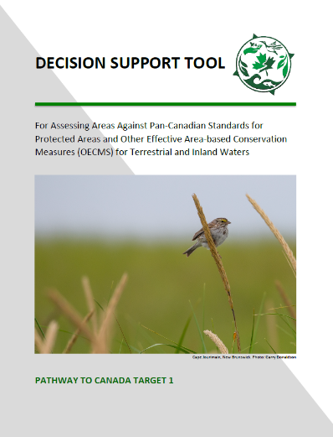


Using the
Decision Support Tool

Slide 2
Before You Begin Screening
Familiarize yourself with the key elements and definitions related to PAs and OECMs in the glossary of terms and FAQs
    In-situ conservation (holistic): The conservation of ecosystems and natural habitats and the maintenance and recovery of viable populations of species in their natural surroundings and, in the case of domesticated or cultivated species, in the surroundings where they have developed their distinctive properties. (CBD Article 2).
    Biodiversity (holistic): the variability among living organisms from all sources including, inter alia, terrestrial, marine and other aquatic ecosystems and the ecological complexes of which they are a part: this includes diversity within the species, between species and or ecosystems (CBD article 2)
Familiarize yourself with DST and interpretation guidance and FAQs
Gather useful information sources for screening
  E.g. site history, legislation, regulations (surface and subsurface), policy, maps, management plans, corporate bylaws, research / monitoring results, use data, site condition assessments, management effectiveness assessments, species proxy data (harvesting reports), or discussions with knowledge holders, site managers
Notes:
In situ conservation is a core element of every site under target 1. The definition for in situ conservation (and biodiversity and others) can be found in the D-S-T glossary. These are drawn from the international Convention on Biodiversity, and are important in distinguishing the role that protected areas and O-E-C-M s play alongside many other approaches – including on modified landscapes - to conserving biodiversity.
While the D-S-T is intended to include the key information needed to support screening, familiarity with the CBD and other national and international guidance is important.

Slide 3
Before You Begin Screening…
3. Determine the “mechanism”
  You may actually be screening MORE THAN ONE mechanism
  Consider how tools actually function together
  Mechanism: Refers to the legal or other effective means used to protect or conserve the area. Mechanisms may include but are not limited to legal tools (e.g., gazetting & recognition under statutory civil law), recognized traditional rules under which community conserved areas operate, policies of established NGOs and other private landowners, Natural/Indigenous Law, or customary laws
4. Consider ‘who’ should be involved in the screening process
  Reporting requires consent
  On the ground site knowledge and jurisdictional context is critical – the devil is in the details
5. Completion of rapid pre-screen against all criteria for “clear misses”
  e.g. Site being evaluated MUST:
    result in conservation of biodiversity in-situ (some level of ecological integrity)
    have stated objectives
    not be temporary
Notes:
In situ conservation is a core element of every site under target 1. The definition for in situ conservation (and biodiversity and others) can be found in the D-S-T glossary. These are drawn from the international Convention on Biodiversity, and are important in distinguishing the role that protected areas and O-E-C-M s play alongside many other approaches – including on modified landscapes - to conserving biodiversity.
While the D-S-T is intended to include the key information needed to support screening, familiarity with the CBD and other national and international guidance is important.

Slide 4
Decision Support Tool (DST)
Includes standards and interpretation guidance for 9 screening criteria
+ reporting template tool
All 9 criteria are aligned with International definitions and guidance on PAs and OECMs
Table 1: Standards common to both protected areas and OECMs
  Geographical Space
  Effective Means-1
  Effective Means -2
  Long-term
  Timing
Table 2: Standards that differ between protected areas and OECMs
  Primacy of Objectives
  Scope of Objectives
  Governing Authorities
  Biodiversity Conservation Outcomes
Notes:
The Decision Support Tool includes two tables of reporting standards, complimented by a narrative interpretation guide that provides guidance for assessing areas against the standards.
Table 1 outlines standards common to both protected areas and O-E-C-Ms.
Table 2 includes standards that differ between protected areas and other effective area-based conservations measures. Table 2 helps in deciding whether an area is a protected area, an O-E-C-M, or neither.
The screening criteria are listed here under interpretation guide. Each of these criteria is paired with standards in tables 1 or 2.
Additional Notes:
All criteria must be met
These criteria are the minimum set
No criteria are unimportant
If any one criterion is not met, an area is unlikely to effectively conserve biodiversity over the long term
Most criteria speak to ‘potential effectiveness’ of the mechanisms, not ‘realized effectiveness’
‘Realized effectiveness’ is primarily addressed by the “Biodiversity Outcomes” criterion

Slide 5
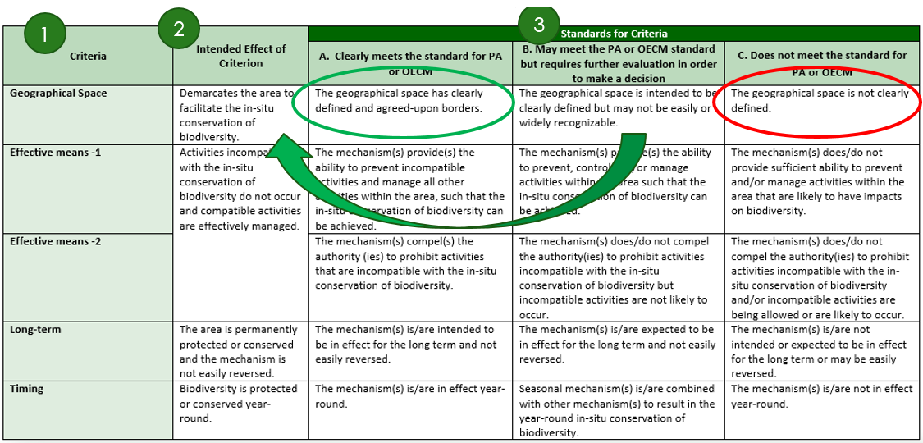
Using the Standards Tables
Site must be evaluated against ALL 9 criteria (1)
In determining which standard applies (3) – look to the “intended effect of the criterion” (2)
  In some cases it clearly does
  or does not meet the standard
  In most cases it requires further
  evaluation or assessment in order to
  make a decision
  Consider interaction of criteria –
  evaluation may not be step-wise
  Use the Interpretation guidance
  and FAQs
Outcomes:
Meets protected area standards for all criteria = report as a protected area
Meets either protected area or O-E-C-M standards for all criteria = report as an OECM
Failure to meet any one criterion standard = site does not meet eligibility for reporting
as either PA or OECM
Notes:
In the tables, each criterion has a series of standard statements that can be evaluated against the intended effect of each criterion.
If the area being screened clearly meets standard A for instance, then it passes that criterion. In this case, the geographical space is clearly defined.
If the area being screened is best described by standard C, then it does not meet the criterion, and cannot be reported as a protected area or O-E-C-M. If desired, screening can stop here, but it is recommended that areas be screened against all criteria to identify gaps and areas for alignment with criteria.
CLICK 6 – Recognizing that areas can vary significantly in how standards may be met, if the area is best described by the standard B statement, the reviewer needs to decide whether the measures in place meet the intended effect of the criterion – if so, the area can be evaluated as meeting the criterion, and consideration may be given to improving the quality of the standard if possible. If the intended effect is not being realized, the area should not be reported as a protected area or O-E-C-M.
An example of an area best described as meeting standard B for this criterion might be a privately conserved area that is well delineated through legal ownership documents, but not widely known as a conserved space due to landowner wishes.

Slide 6
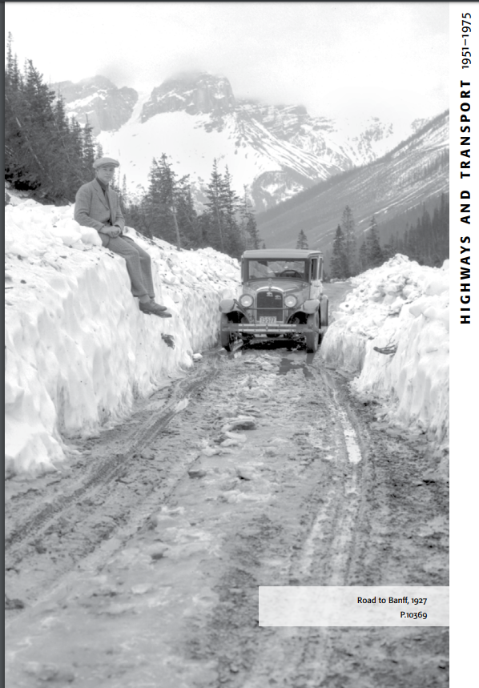
Table 1 Criteria
Standards common to both PA and OECM evaluation

Slide 7

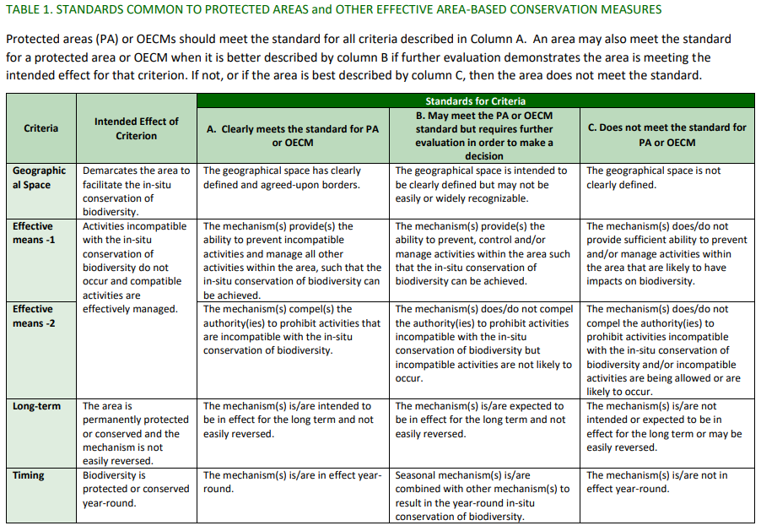

Slide 8
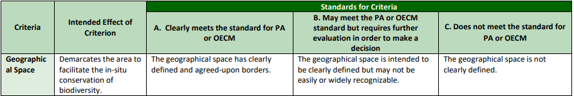
Geographical Space – how do you define the space?
Intent: The area is spatially demarcated to facilitate in-situ conservation
Considerations:
  What tools are used to define the boundary?
  Are the boundaries agreed upon?
  Is the boundary public or at least available to decision makers?
  Is the qualifying space a subset of a larger area?
  If so, how is that subset also delineated?
  Is the boundary moveable?
  Links to Long Term
Notes:
GS – examples: on the ground signage; maps – online or printed; legal descriptions (OC or land title)

Slide 9
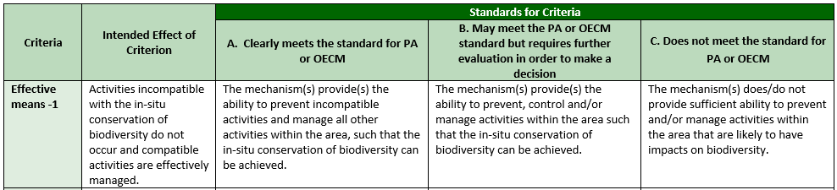
Effective Means-1 – do you have the tools you need?
Intent: Incompatible activities do not occur and compatible activities are effectively managed
Considerations:
  How is the site used and managed? What is the range of use that occur on the site?
    (interaction: Who else would be considered the governing authority of those uses, elements – e.g. wildlife?)
  What kind of impact do those uses have on biodiversity?
  Is the type and intensity of use compatible with in situ conservation or incompatible?
  What authority or means are used to prevent, manage, control uses?
  Does the management of activities – (incl. potentially compatible activities) result in no or insignificant impact on conservation values?
Notes:
can you do what you need to do?” and EM 2 is “do you have to do what you are supposed to do?”

Slide 10
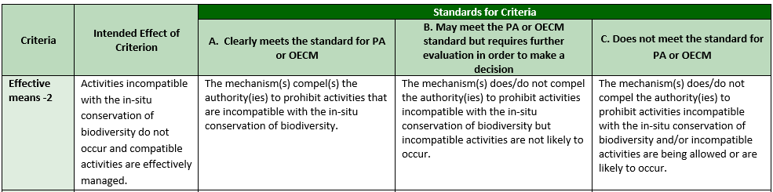
Effective Means – 2: Are the tools being used to prevent incompatible activities?
Intent: Incompatible activities do not occur and compatible activities are effectively managed
Considerations:
  Are incompatible activities (e.g. mining) occurring?
  By what means are environmentally damaging industrial activities and other incompatible activities being prevented?
  Does the governing authority have to preclude incompatible activities?
  How likely are incompatible activities to occur?
  Are there indications or an expectation that they will occur in the future and could not be prevented?
  Are there means to appeal or reverse the prevention / preclusion of incompatible activity?
Notes:
can you do what you need to do?” and EM 2 is “do you have to do what you are supposed to do?”

Slide 11
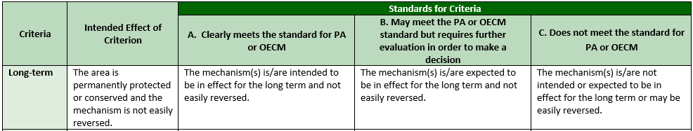
Long Term – How long is the space intended to be around?
Intent: the area is in place for the long term and not easily reversed
Considerations:
  Is this a temporary site?
  What are the indications of long term intent?
  Is there a clear “due date” for an agreement?
  How difficult it is to rescind protection of the area? Is it a common or recent occurrence in similar sites?
  How difficult is it to change the intention of the area? What is the level of authority required for change?
  What safeguards are in place to prevent reversal?
Notes:
On long-term, one of the things we’ve spent a lot of time talking about is what happens at the end of an agreement. A 50-year agreement that renews by default is perhaps long term, but one that does its time and dies is not.

Slide 12
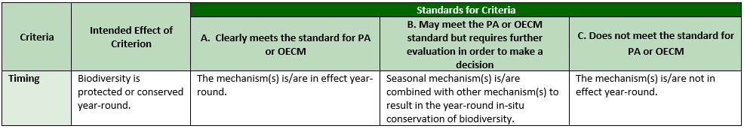
Timing – are protections year-round?
Intent: biodiversity is protected year-round
Considerations:
  Are the measures that result in conservation seasonal, or in place for only a specific timeframe?
  If so, do they function with a suite of additional measures to provide protections year round?
  If so… the full suite of mechanisms must be evaluated collectively

Slide 13

Table 2 Criteria
Standards that differ between PA and OECM evaluations

Slide 14

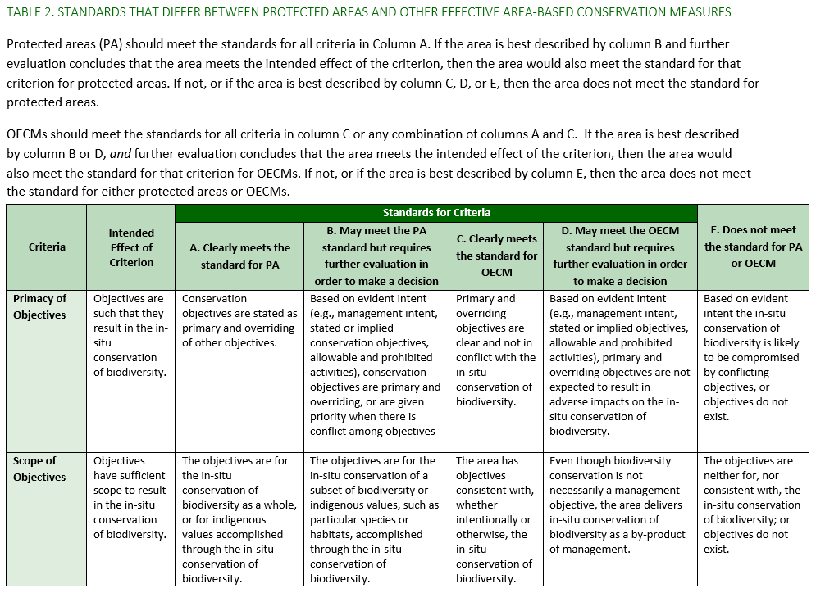

Slide 15

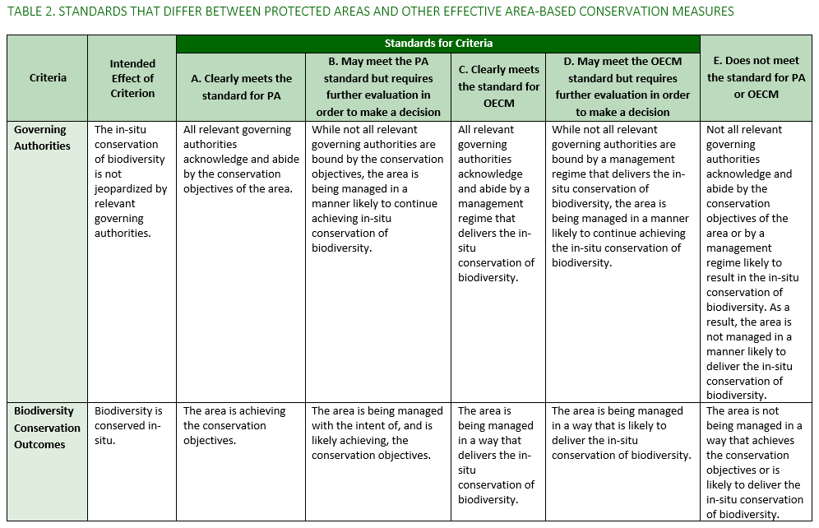
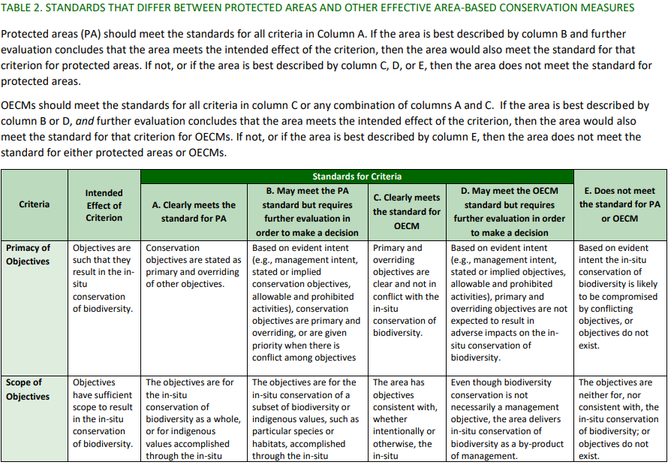

Slide 16
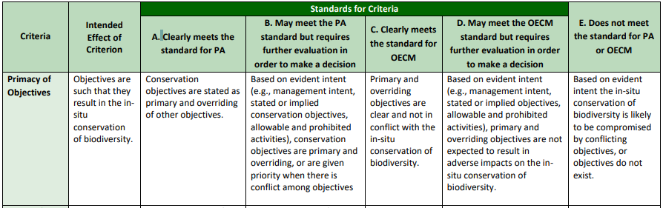
Primacy of Objectives – who wins when there is a conflict?
Intent: the area’s objectives are such that they result in the in-situ conservation of biodiversity
Considerations:
  What are the primary and overriding objectives of the site?
  Are the site objectives and their relative primacy clearly stated or are they inferred / assumed?
  Are there objectives for conservation? Do they have primacy over other objectives?
  Are there potentially competing priorities?
  How are they compatible with and result in the in situ biodiversity conservation?
  Are stated objectives consistent with the type and scale of activities allowed and their impacts?
  Are the primary objectives expected to endure?

Slide 17
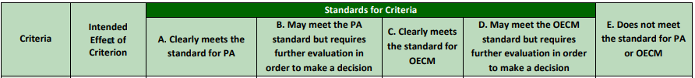
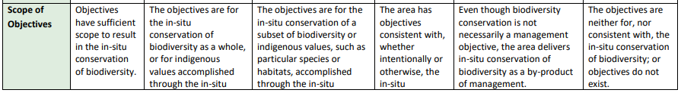
Scope of Objectives – what is included?
Intent: area’s objectives have sufficient scope to result in in-situ conservation of biodiversity
Considerations:
  What is the focus or result of objectives?
  Are objectives broad enough to result in good outcomes? (i.e., objectives met = biodiversity happy)
  What elements of in situ biodiversity are protected?
  Regardless of objectives - Is the site managed in a way that biodiversity as a whole is protected/not undermined?
  Does site management or approach compromise some elements of biodiversity?
  Are site objectives consistent with, and if so, how do they result in, the in situ conservation of biodiversity?

Slide 18
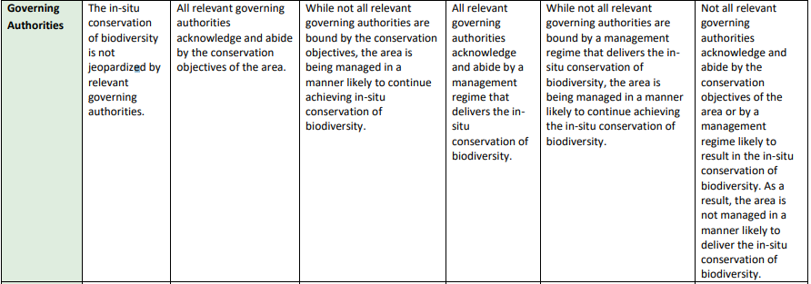
Governing Authorities – who is in charge of what?
Intent: in-situ conservation of biodiversity isn’t jeopardized by relevant governing authorities

Slide 19
Governing Authorities – who is in charge of what?
Considerations:
  Who ELSE is responsible for (permitting, prohibiting, granting or determining) activities impacting biodiversity on the site?
  How does their management of those activities impact biodiversity? Is it consistent with conservation?
  Can activities or determinations be authorized by another governing authority?
  How are multiple authorities reconciled - who trumps who, and on what?
  Who manages and permits subsurface rights under the site? Are they tied to surface rights?
  The vast majority of land has MULTIPLE governing authorities – who has authority over what?

Slide 20
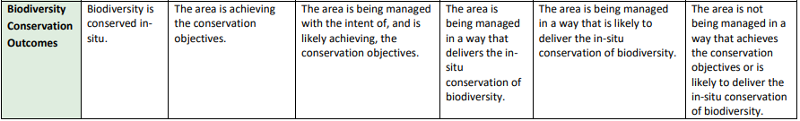
Biodiversity Outcomes – what is the result?
Intent: Biodiversity is conserved in situ
Considerations:
  Has the condition of the site assessed? How?
  HOW is the site management likely to result in biodiversity outcomes?
  Are you monitoring? What are you monitoring?
  If no monitoring, do you have other evidence of biodiversity outcomes?
  What is the condition of biodiversity on site (structure, function, abundance etc.)?
  PA = must meet objectives; OECM = must result in good outcomes
  * This criteria is the only one about “realized effectiveness - the others are only looking at “likely” or “expected” effectiveness

Slide 21
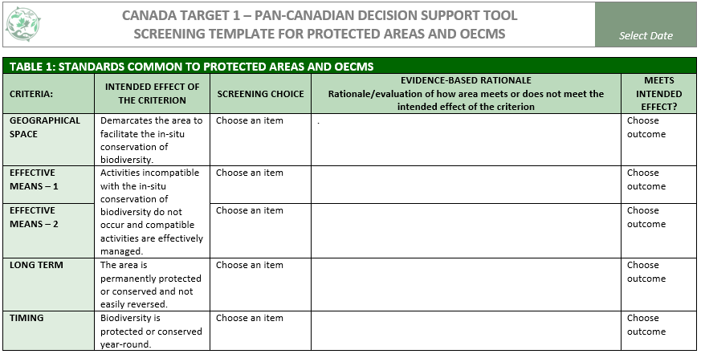
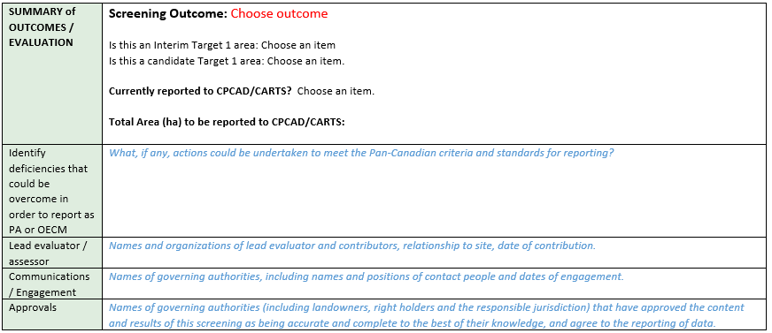
Reporting Template
5
4
Notes:
The D-S-T screening process is aided by the use of a standardized screening template. Available in Microsoft Word – on the Conservation Tools webpage, this template has drop-down selections for screening choices and outcomes.
One of the useful elements in the template – is the ability to outline any deficiencies that could be overcome if the mechanism fails on any one of the criteria. It is intended to provide a record of evidence and rationale for reporting, and may be very useful where multiple agencies or authorities may be involved in site management or screening. We are looking for ways to continually improve, so we are taking suggestions and feedback for improvement or change – we will be talking about that on Friday morning.
CLICK 1 – It also provides a space to add rationale for the screening decision. It so strongly recommended that this section be completed to make a record of the screening, but also as a means of identifying any gaps that could be addressed to help the area meet reporting standards.
CLICK 2 – The final rows provide an opportunity to select an overall screening outcome.
CLICK 3 – space is also provided to summarize gaps or deficiencies that could be addressed if there is an interest in seeing the area reported as a protected area or O-E-C-M.

Slide 22
Working with the DST is the best way to understand the DST
Context and site expertise is critical
No one has all the answers…yet
Challenge your own biases and assumptions
Multiple perspectives are very helpful
Involvement of all the governing authorities is helpful and respectful
Final decision on reporting is at the discretion of the jurisdiction
Consent to report is required

Slide 23
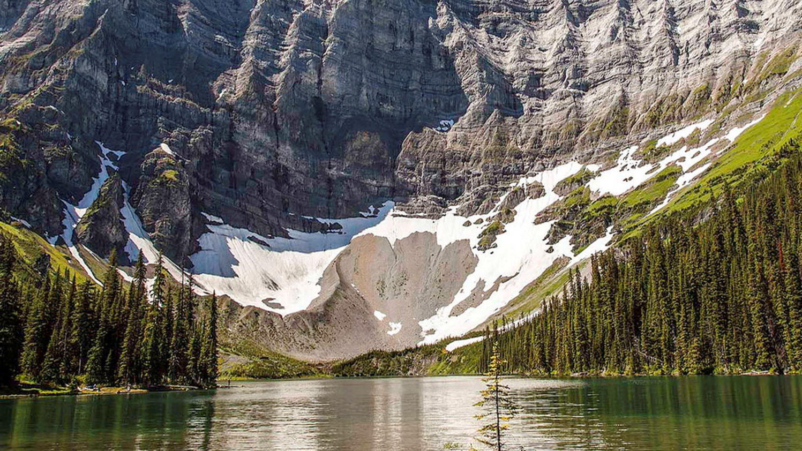

Questions?
Heather Lazaruk, CCEA Director

